Slide 2
St. James Food Basket
Purpose:
To provide nutritious food to those in need and to foster a vibrant community who will actively advocate for community wellbeing.

Slide 3
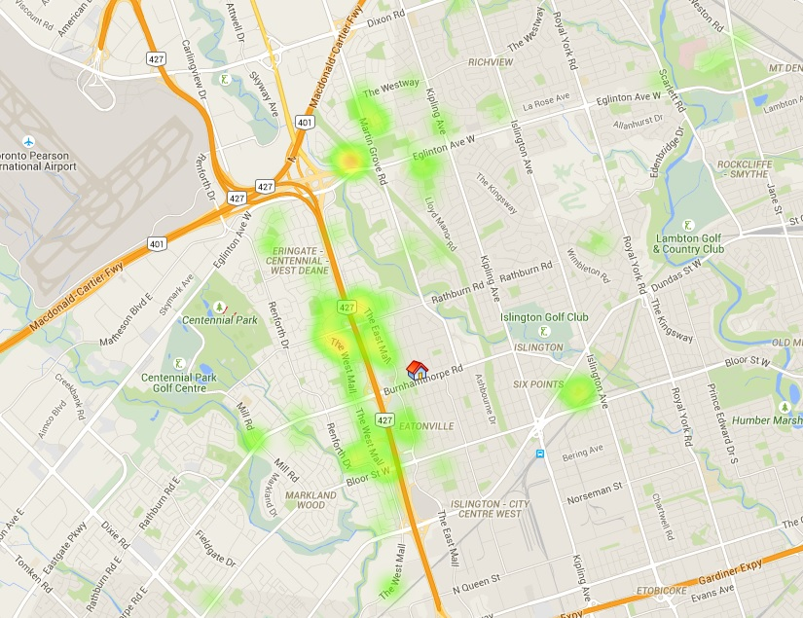

Slide 4
The church was approached by the Social Planning Council and Daily Bread – because a food bank was needed in the area. The Social Justice working group took on the project – getting commitments from this church and most others in the neighbourhood.
Why so many? Advocacy. & “pop up” requires more volunteers than a permanent food bank.

Slide 5
PARTNERS:
11 churches (Bloordale United,
Richview United, St. Phillips Lutheran,
Graceview Presbyterian, Renforth Baptist, Nativity of Our Lord Roman Catholic,
Christ the King Anglican, Good Tree Korean), Rehoboth Christian Reformed, St. Clement Roman Catholic, St. Gregory Roman Catholic
Tzu Chi Buddhist Foundation
Memon Association of Canada
Muslim Welfare Centre

Slide 6
Now that we have been operating for more than 8 years, we have many other partners:
- local businesses who donate food;
Toronto Public Health
An employment centre
Etobicoke Services for Seniors
Etobicoke Rotary

Slide 7
First Wednesday in November, 2015
194 families attended representing 412 adults and 188 children (under the age of 16)
10 households were new that day: a total of 14 adults and 11 children
43 attendees were 1-person households. 12 of these were seniors.

Slide 8
Our food has become more healthy over time: Daily Bread now fresh produce;
Buying at the Food Terminal
Monthly provision of a simple vegetable recipe

Slide 10
We are a “pop-up” food bank. We start setting up at 7 a.m. On Wednesdays; by 6 p.m., everything is away (although a cleaning is needed)
We pay no rent. The church pays for cleaning of the facility, supplies for washrooms, paper towels.
We pay for regular kitchen cleaning, dishwasher detergent, pest control.

Slide 11
We have a walk-in fridge and freezer (Trillium grant). The church pays for the extra utilities.
We are all volunteers – there is no staff.
All of our funding is through donations and a few grants.

Slide 12
These limitations mean we must constantly re-focus on our main goal of providing food
We do not have the capacity (human, space) to provide more and more services
We rely on agencies to provide services to our people

