Slide 1
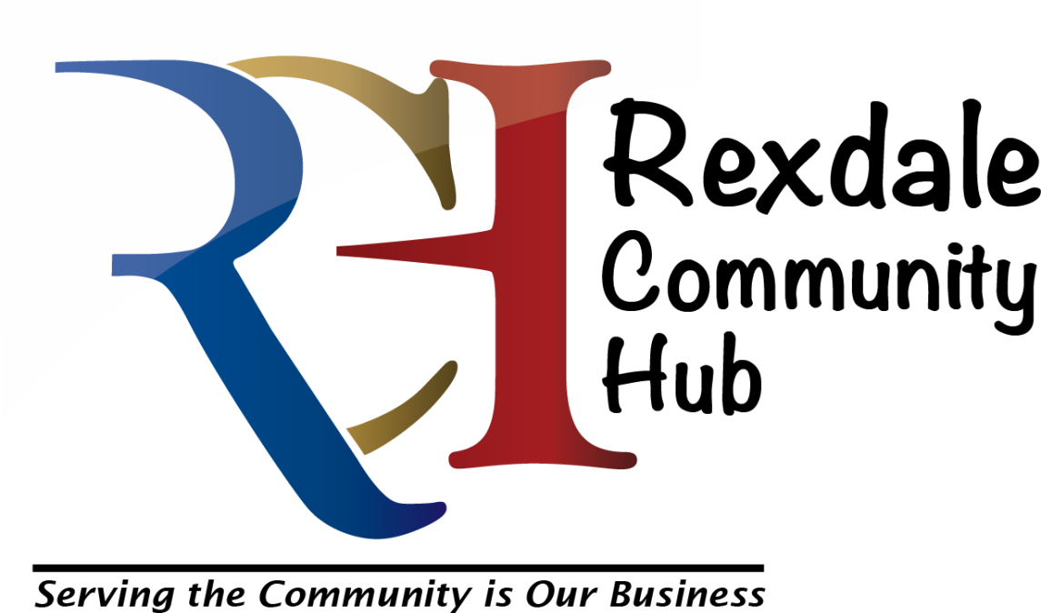
Presentation to Toronto West Local Immigration
Partnership
November 19, 2015.
Ann McRae, Director of Legal Services,
Rexdale Community Legal Clinic and
Chair, Rexdale Community Hub

Slide 2
This presentation in a nutshell
The hub model
History
Steps to achieving a hub
Hurdles
Key accomplishments and successes
Challenges
Take-aways for those wishing to collaborate in hub-type setting
Notes:
Topic for panel:
Showcasing the work of successful shared services and understanding the challenges and benefits faced.
Topic for me:
To speak about shared services with the reference to the Rexdale Community Hub
The RCH is the largest of about seven or eight in Toronto, has a unique management model and is in Etobicoke, so I am going to sketch a bit of how we got to be so lucky, and what that means for service delivery.
Also, what have we learned, and what could be improved.

Slide 3
Recipe for a hub
Ingredients you will need:
Location ready to renovate, or $1B
Partnership of agencies to do the visioning
Group of people to reflect and add community values and requirements into the planning stages
Political support : someone is going to oppose, so you need champions
Funding support; for consultation, design, approvals, construction.
Convert mission and vision statements to co-location agreement, partnership agreement, leases, legal obligations
Policies for operating and managing a shared environment
Takes about 5 years of planning and consultations to go from concept and finding a location until occupancy.
Serves thousands.
Notes:
Here’s my recipe for a hub. It’s a lot of work, and seems to take forever.

Slide 4
How to Grow a Hub from Seed
2007 – ANS obtained a grant to hire a consultant, who surveyed community need.
2012, Spring: occupancy by 11 agencies.
The issues identified in 2007 are the same eight years later:
How will it work in practice?
What is the model?
How is it governed
Who gets to locate in the hub and who doesn’t
What expectations of hub partners?
What is the long term vision?

Slide 5
Accomplishments
A file cabinet full of community consultations, reports, partner meetings over several years.
The mission and vision statements developed ( and now embedded in our Bylaws and Co-location agreement).
Money gathered and spent
renovations completed
staff hired
building occupied except for RCHC in a large ground-floor unit.
Notes:
First bullet, a lot of talking.
Second, try to distill all that talking into some directions and maps.
Money : get it, spend it
Building design and construction: exciting but that can be a form of waking nightmare.
Staffing
Occupancy

Slide 6
How does it work? (Original pompous title: Hub Governance Model)
City of Toronto is the landlord
The City determines who occupies, and how much rent they pay, security etc.
No single agency acting as landlord or landlord’s agent (vs. Unison)
We had to invent a management system and a way to pay for front desk staffing, room bookings, wifi, maintenance, cleaning, and getting the partner agencies to play nicely in the sandbox,
Notes:
This is the governance slide.

Slide 7
The RCH corporation
Rexdale Community Hub is a charitable corporation managed by a volunteer board of directors. Its sole function is to manage the facility, with a view to honouring the community’s wishes.
4 reps from tenant agencies, usually the EDs
3 residents of Rexdale, initially selected by a community consultation process
3 members at large, with some connection to Rexdale, to fill any gaps in capacity and skills
Notes:
Inventing the wheel that we need.

Slide 8
Successes / challenges
Proximity is a big factor in successful collaborations
Having shared “program” space such as a gym, meeting rooms of various sizes is enormously helpful
Speedy, informed referrals are a great boon to our clients
but it is only one factor.
can be a source of conflict)
it takes an investment of time and effort to build and sustain relationships
Notes:
Successes:
1. Proximity: The other factors in successful collaboration is communication, communication, communication. Plus some personal goodwill, relatoinships etc. but it will always come back to communication. Emails, phone calls, meetings, whatever. Examples: RWC
2. Program space: this is one of the hub’s greatest assets, and also the source of the most conflict.
3. Referrals. Maximizing the proximity factor. One stop shopping is the ideal.

Slide 9
Addressing the Challenges
Sharing of agency information needs to be structured, otherwise it does not happen
Organizers of collaborative events have to be deliberate in inviting, and planning, in order to maximize partners’ involvement
Relationships with external-to-hub agencies can suffer
Programs and even partners are unstable, shifting with the winds of funding and politics
Notes:
e. g. getting all agencies to regularly share the list of their staff, what they do and their contact info. This is not a hub issue, it is applicable to all agencies who share cross-referrals, but it is astonishing how much work it is in a hub.
2. We have several times entered the building and discovered an event at which we think the legal clinic presence and participation would have been a natural fit. Where possible, we have stepped up, but we then have to assess: did we miss a critical email? Did we fail to follow up or was the organizer a “new hire” who was unaware of our presence or our mission? So, as with external-to-hub events, you can never assume. And we all suffer from email-fatigue, as well.
3. Extra effort is needed to deal with external-to-hub partner agencies, because one’s world can shrink to the happy buzzing hive of activity that is the hub. All agencies can forget to extend the extra effort to constituents who live more than eight or ten blocks away, and this can be even worse in a hub.
4. You may come to rely on a person or a program that turns out to be transitory, and suddenly gone when you call up to make a referral. So, there is no panacea, you have to constantly refresh your information about partners’ services, where to get help for the mentally ill, the drug user, the gang member. The more critical a service is, the more tenuous its funding source, and the more unstable its workforce, e.g. in newcomer services or youth-at-risk . On the flip side, long-standing services become victims of their won success, so stretched that they develop ridiculous waiting lists and lose the capacity to deal with your requests. (Example: the Rent Bank, womens’ shelters and the B. Schlifer clinic, victims of their own success). These aren’t hub issues, but they also occur in hubs, and it is jarring when you come to rely on someone else’s staff member who is suddenly gone.

Slide 10
What have we learned?
We have learned the limitations of each others’ funding and programming.
We have learned that the cat-herding of hub operations and agency collaboration takes resources (staff, funds, space, a management layer, a plan to make the magic happen) and there is no one funded or mandated to make that happen.
Hubology, or the maximizing of the hub opportunity, is a developing science
Notes:
Learning about each others’ services is also to learn each other’s limitations. Always, it’s about funding.
The visionaries who got hubs going must be honoured, but as time unfolds, we see the failure to plan for the space, funding and leadership to take us to the next level. We all (agencies) aspire to fully collaborative, coordinated intake and referrals, software and employees to screen and direct people to services. We have not met the first levels.
See next page for hubology

Slide 11
Hubology
We are coming to the end of the first decade of hubs as an ideal of community service delivery.
Many management models have been tried, usually with a lead agency, and varying degrees of democratic input from “the community” and the tenant agencies.
Community involvement and accountability is at once the touchstone and the least understood aspect.
Notes:
All hubs have community mission statements. These speak as if the community had a single mind and voice, a significant role in governance, and would have no trouble sorting difficult issues. But two issues are going to bring hubology out of its infancy in a hurry:
One is financial sustainability. The overhead charges, in addition to rent, to maximize partner collaboration, or to open on weekends for sports, or to adapt the gym for community theatre and concerts, or to provide sufficient security for evening uses for theatre, film festivals, etc. There are two ways to approach this, both of them catastrophic for the community:
1. rents would quickly rise to close to commercial levels, if all of the community’s creative ideas and requests were to be heard. This would drive out the tenants with the largest space needs for youth programming, or the tenants with the weakest funder support. This is an unintended consequency of giving the community its voice.
2. Conversely, the only way to avoid charging “community use” charges to the tenant agencies would be to extract user fees from theatre groups and other users. This would disadvantage new and non-profit groups.
The second rite of passage for hubs, I predict, will be finding whose “community voice” trumps.
And example is the policy over use of RCH space for political or religious activities. We have been approached many times for both types of activities. We can hold an all-candidate meetings, but not a rally for a particular candidate or even a particular issue. We CAN hold public forums with panels talking about all aspects of an issue such as global warming or domestic violence. Can we have a march for more affordable housing that begins and ends at the hub? Perhaps not. And yet wouldn’t this fall within the types of community needs that would get almost universal support?
Religion is even trickier. “The community” knows that we have public-use rooms un-used on the weekends and at other times. Faith groups are in need of inexpensive meeting spaces. That is a bit sad, but is the only way to be fair to all. But there are grey areas: an organization wants to run an adult training event for members of his faith, as wants us to treat it as educational, not as promoting his faith. Where would we draw the line? Because there is no worship service, no prayers, it is not a Christian event? Should we permit this? And if we do, how do we balance the interests of one community group against another, or prioritize competing requests from various youth groups or seniors groups or anything that is open only to one faith group.
My point isn’t about defining the use of space, it is about defining the community voice. Is “the community” a majority-rule organism? It is the most ill-defined word in social planning, in my view. As a result, it has no meaning at all, and is just a placeholder in a sentence. “Community” goals and values and aims and opinions could actually include faith groups, the interests of employers, etc. For example, the Woodbine Entertainment Group is a valued external partner, participating in providing food for community events, and sending designated employees to actively participate in planning events. While wonderful, the leverage of a large employer who is also a strong lobbying organzation is a conundrum for me.
Let me offer several definitions of community, each apt in its own context, because the word is an assumed element of any hub’s mission:
The community of those already using the hub and its programs vs. those, even nearby, who do not know what is in the building.
The community of those who can easily walk to the hub vs. the community of everyone near and far who is not served by any other hub.
The community of everyone who is already on our agency networks, and gets our broadcast emails vs. whoever we have omitted.
The community of long-time residents and others who may resist change.
The community of visionaries who want everything to be possible and to happen now. Darn the torpedos, full speed ahead.
The community of agencies and their staff, whose interests in the uses of the building may be self-serving (limited noise and chaos and mess, maximum health and safety).
There is the community of young people who want to hang out in a parking lot, after dark. They aren’t necessarily sinister, but you can see the conflict, I think.

Slide 12
Conclusion
Good news, I’ve reached the end.
Hubs are good for many clients in many ways, but maximizing the good requires just as much effort and cat-herding as any other model.
Staff, funding and planning is needed for shared intake, proper interagency referrals, collaboration.
Hubology will soon be taught in community colleges.
Notes:
All hub agencies have a general mission to collaborate, to make good referrals, etc. but it is low on the priority scale, and NONE of our agencies is actually funded and mandated to provide the support needed for shared intake and really good cross-referrals.
This is true both inside and outside hubs.

