Slide 1
Challenges and Recommendations: Syrian Refugee Resettlement

Slide 2
Topics
About the ACCT
What do we know about Syria?
What have the Syrians been through?
What do we need them to know about life in Canada?
Notes:
What do we know about the Syrian refugees coming to Canada?
Overview of the refugee process
Health Status of Syrian Refugees
What we can and cannot expect when caring for Syrian newcomers?
Meeting primary care needs
Mental Health considerations
What are the potential service and accommodation needs?
Interpreter services
Cultural Safety in service provision
Resources and tools
About the ACCT: Anti-oppression and anti-racist frameworks

Slide 3
Who we are: Arab Community Centre of Toronto:
The Arab Community Centre of Toronto (ACCT) is a non-profit, non-political, non-religious organization that aims to help all newcomers to Canada, especially Arabs, and to provide a friendly place to socialize and reach services and opportunities.
Federal:
Immigration, Refugees and Citizenship Canada (IRCC)
Provincial:
Ministry of Citizenship, Immigration & International Trade (NSP)
Municipal:
City of Toronto (CSP & IIN)
Only fully Arabic staffed settlement agency in Canada

Slide 4
What we do: ACCT Settlement & Community Agency:
Mission Statement:
Offer an array of programs aimed at promoting the full participation of immigrants of Arab and other origins in all aspects of Canadian life;
Provide initial and long-term settlement and integration services for landed immigrants and refugees of Arab and other origins;
Services
Orientation/information/referral
Interpretation/translation
Counselling: trauma
Education – certification of degrees referral
Support groups for adults, seniors and women
Youth programs
Citizenship classes
Conversation circles and computer classes

Slide 5
What is Culture?
Values
Importance placed on time and space
Childrearing practices
Gestures
Social practices
How we grieve
Systems: political, health, legal, education, social, etc.
Behaviour
Dress
Food and eating habits
Music and celebrations
Entertainment
Notes:
Traditional vs non traditional
Religious vs non religious

Slide 7
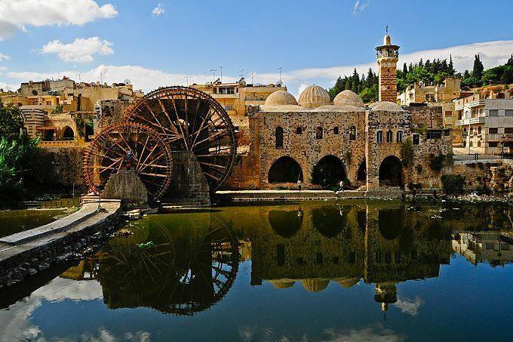

Slide 8
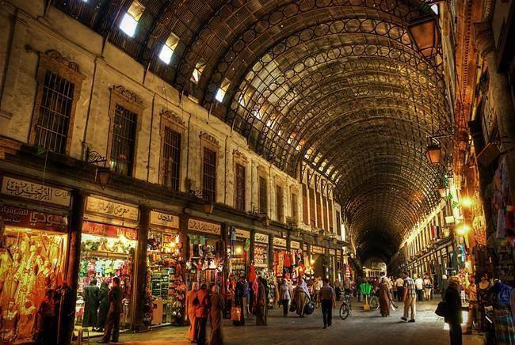

Slide 18
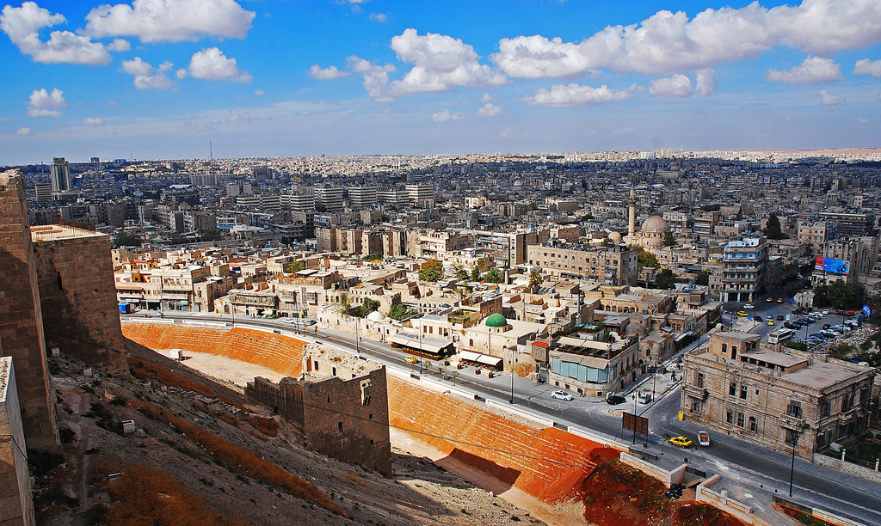

Slide 19
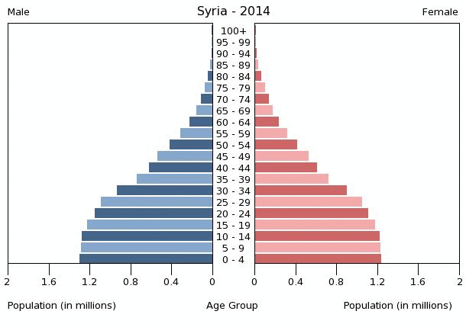
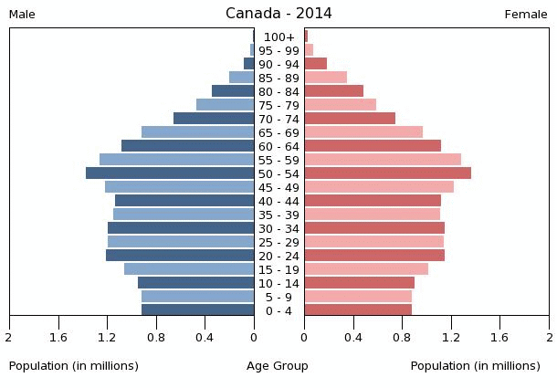
Syria: Demographics
Population of 22 million (2011)
118 per sq. km (3.4)
Median age of 22 (39)
Birth rate of 22.76 (10.29)
Life expectancy at birth
68.75 for males (80)
71.38 for females (84)

Slide 20
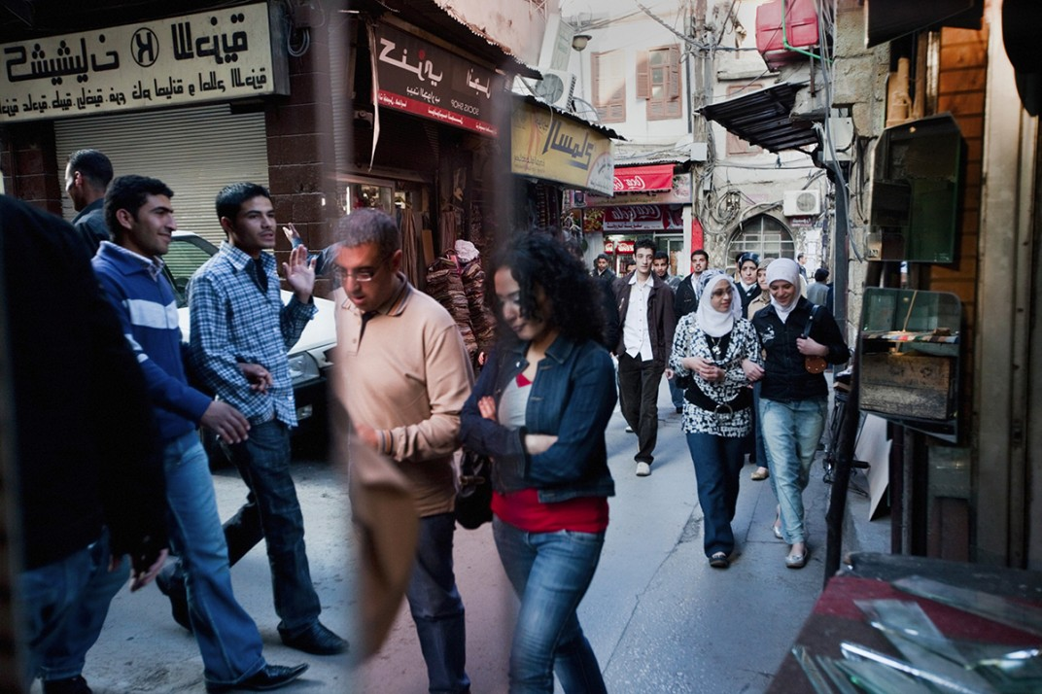
Syria: Ethnic Composition
Arabs make up 90%
Kurds make up 9% of the population
Syriac Arameans/ Assyrians, Armenians, Circassian, Syrian Turkmen, Greeks make up 1%

Slide 21
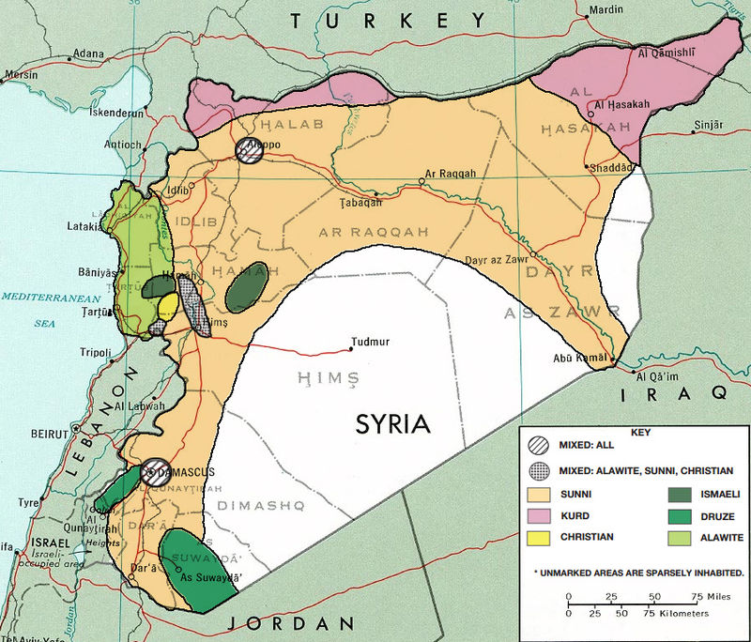
Syria: Religious Composition
Syria’s population is 90% Muslim
74% Sunni
16% Alawite, Druze and Ismaili
Christians make up 10% of the population
Including Greek Orthodox and Catholic
Syriac Christians
Aramaic-speaking Christians
Armenian Orthodox and Catholics
Yazidi community linked to Zoroastrianism and ancient Mesopotamian religions
Notes:
Coexistence, no discrimination
Politicization of religion

Slide 22
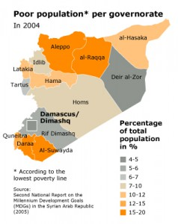
Syria: Economy
GDP 72 billion USD (1.78 Trillion)
1 USD = 50 SYP
11.6% of population below poverty line (2006)
8.84% unemployment rate (2010)

Slide 23
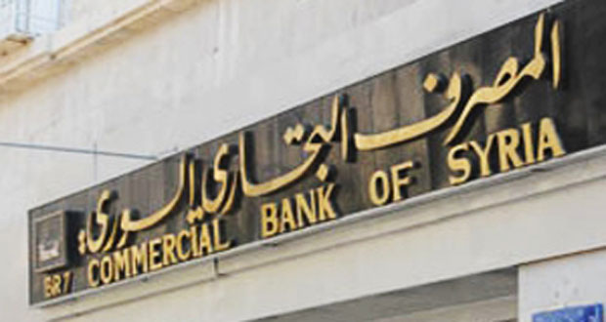
Syria: Sectors of Economy
Agriculture: Employs 17% of labor force, generates 21% of GDP (2009)
Energy: Oil sales account for 25.1% of state’s revenue, only 0.5% of global production (2010)
Industry and Manufacturing: Employs 16% of labor force, generates 27% of GDP
Services: Employs 67% of labor force, accounts for 45% of GDP

Slide 24
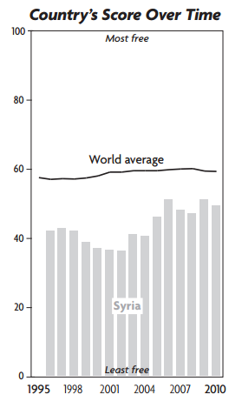
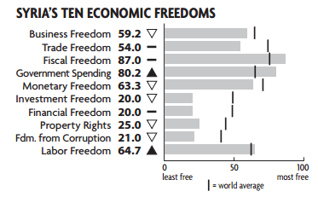
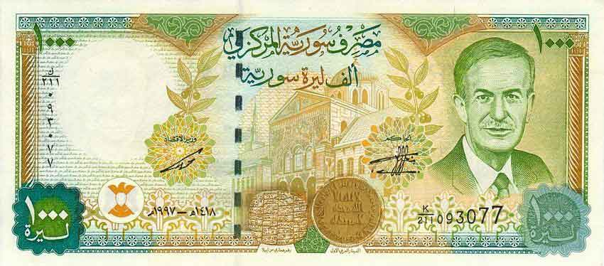
Syria: Economic Freedom
The Heritage Foundation

Slide 25
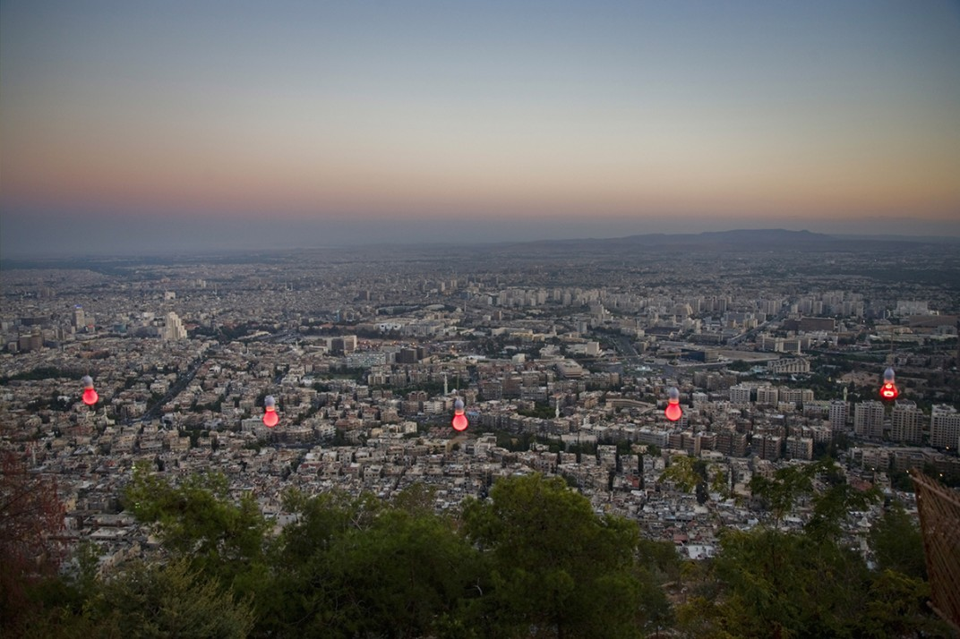

Slide 30
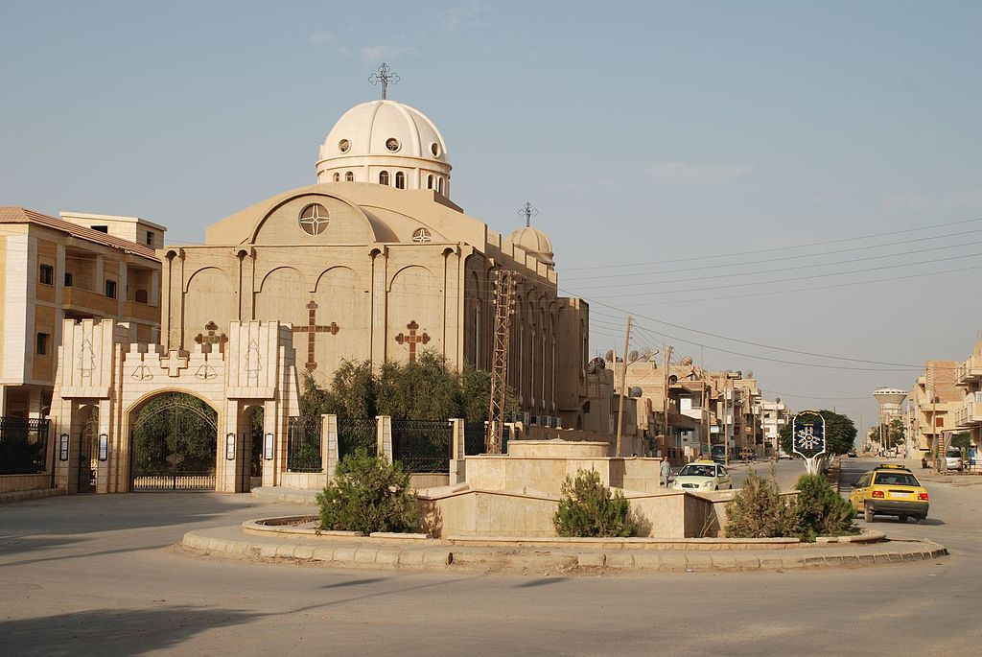

Slide 31
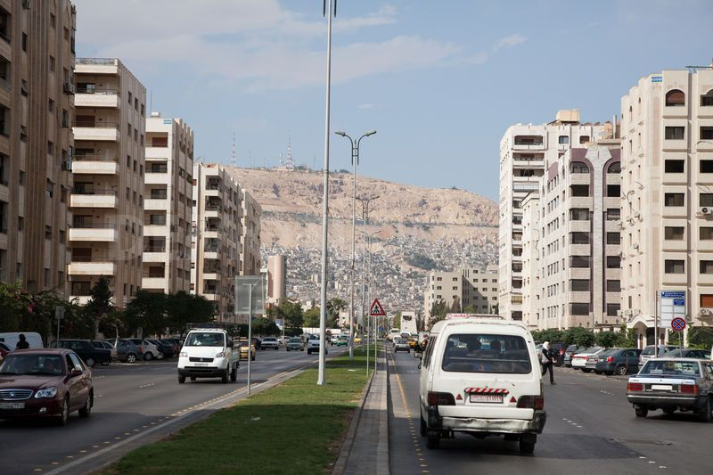

Slide 32
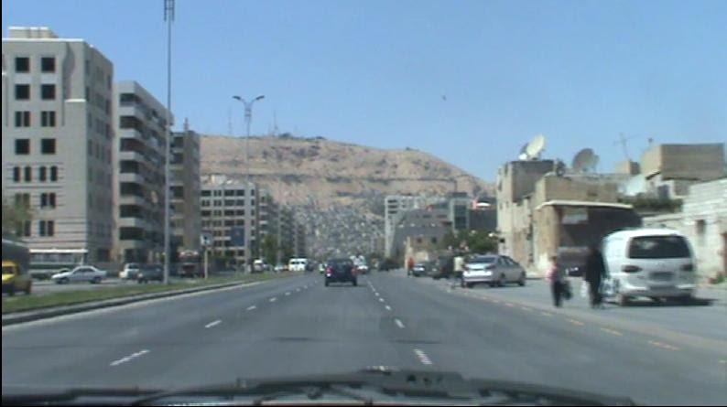

Slide 33
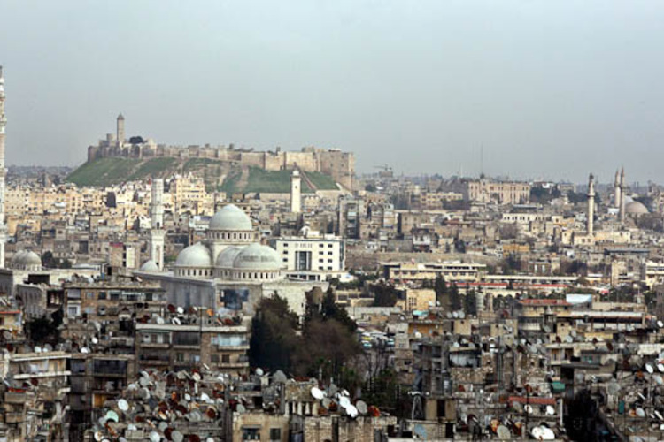

Slide 34
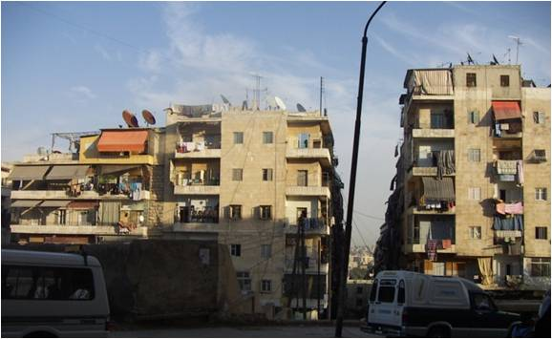

Slide 35
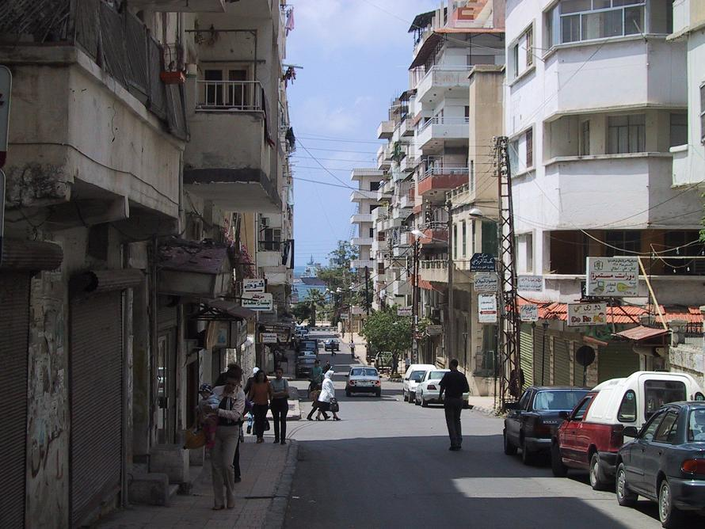

Slide 36
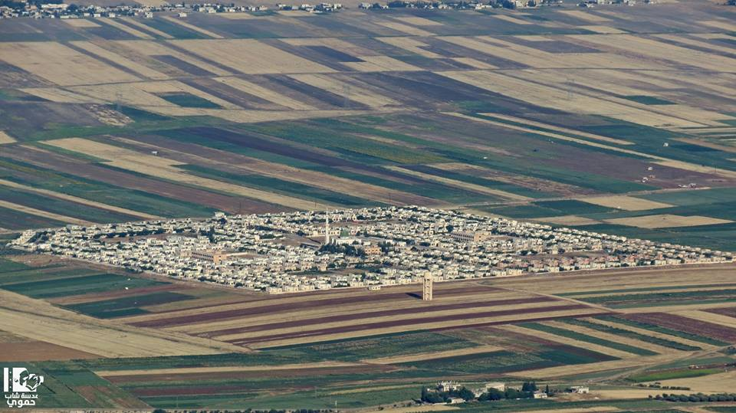

Slide 37
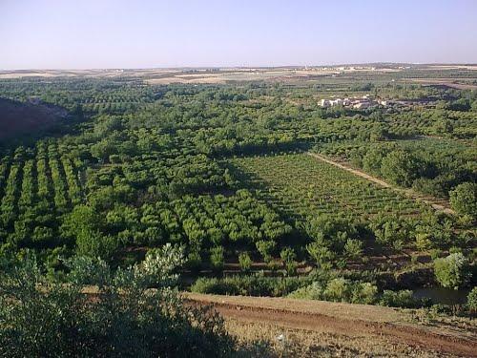

Slide 38
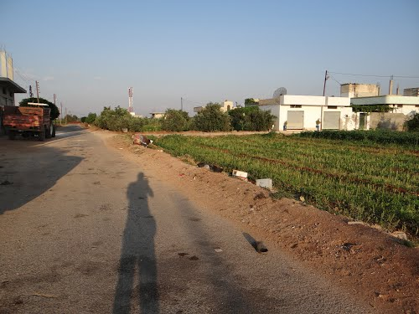

Slide 39
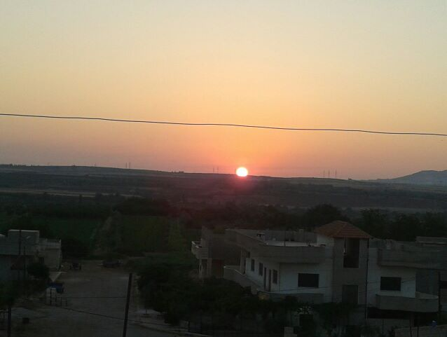

Slide 40
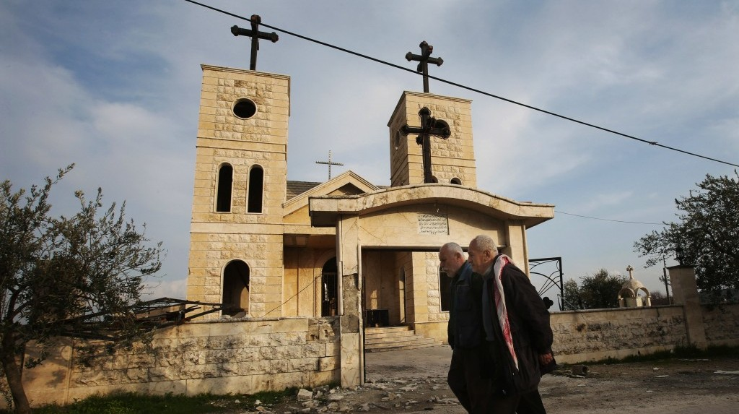

Slide 41
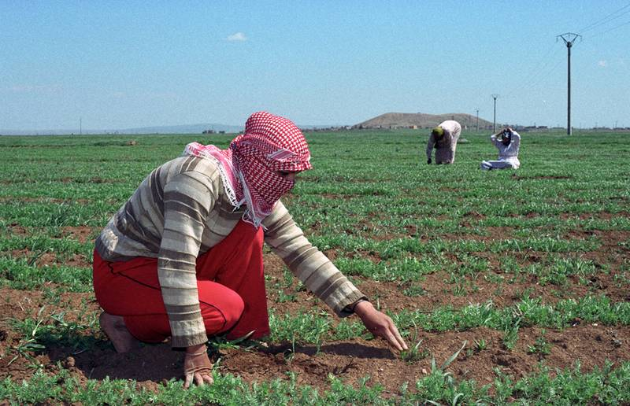

Slide 42
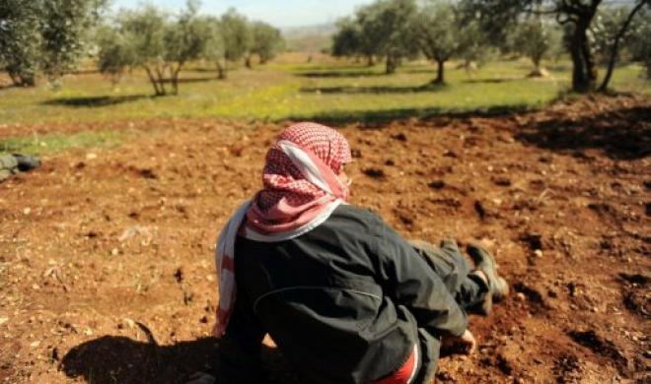

Slide 43
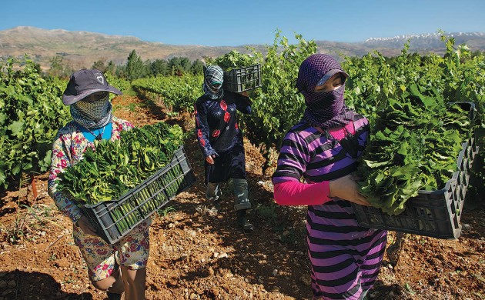

Slide 44
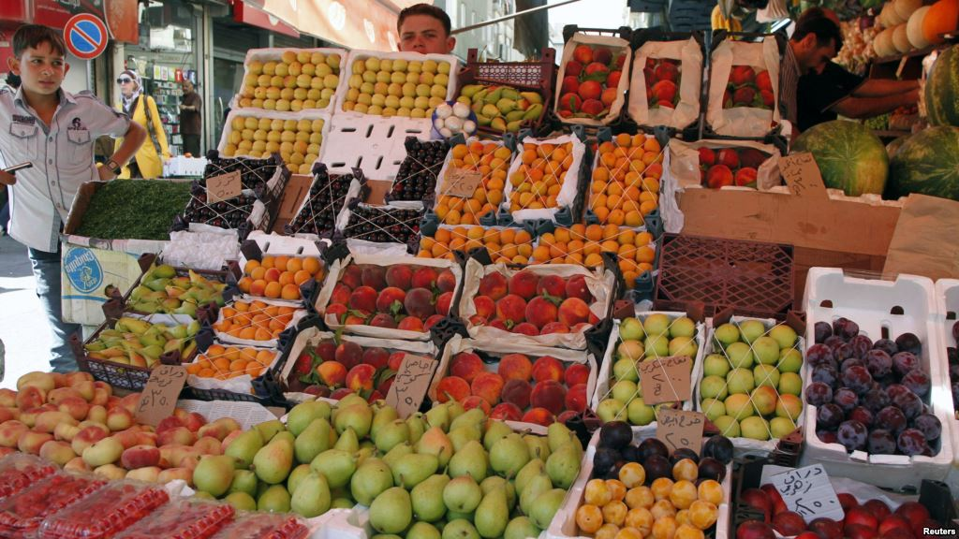

Slide 45
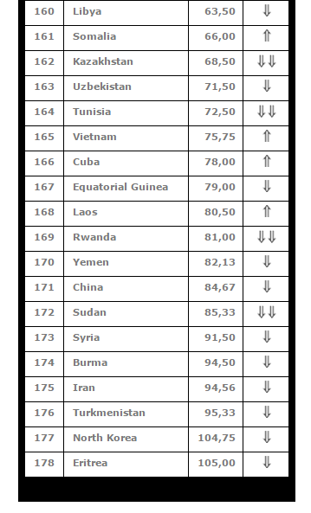
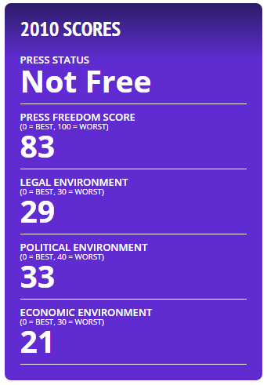
Syria: Freedom of Speech
Freedom House
Reporters without Borders

Slide 46
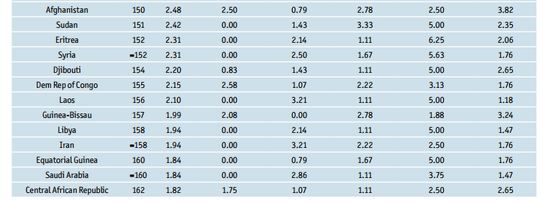
Syria: Democracy
The Economist

Slide 47
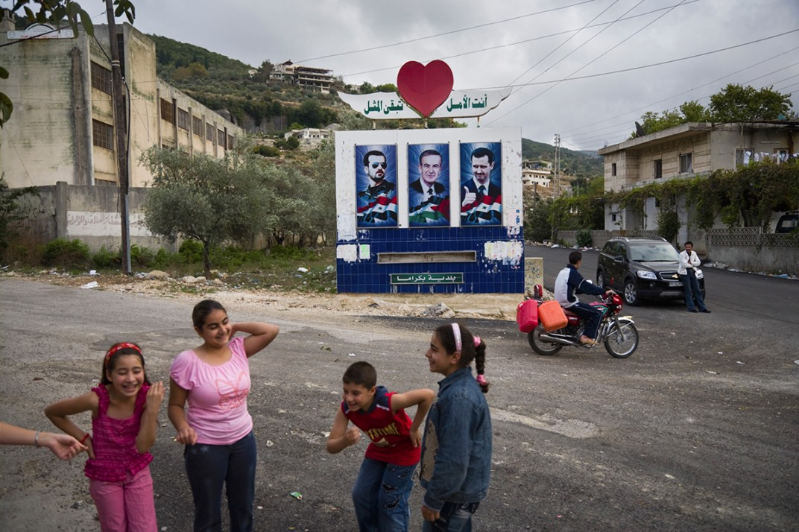

Slide 48
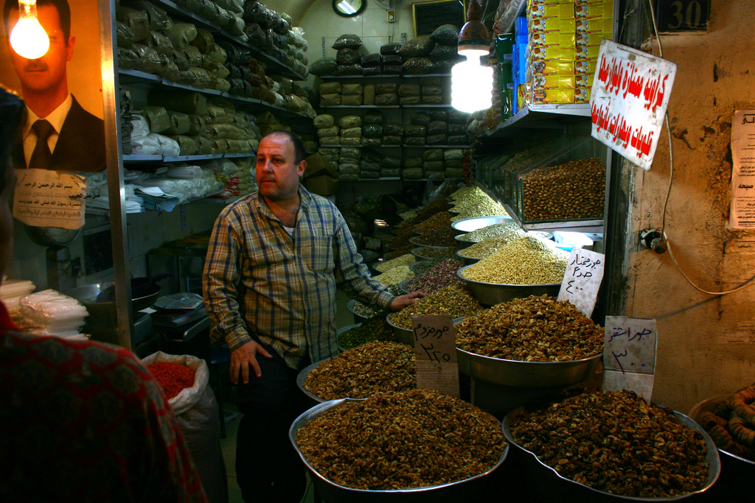

Slide 49
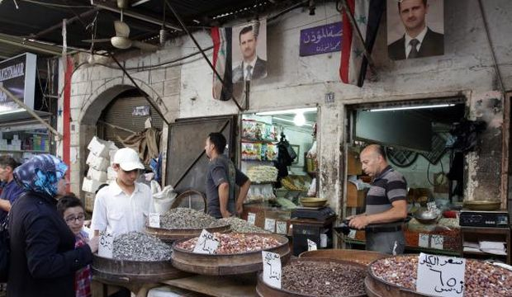

Slide 50
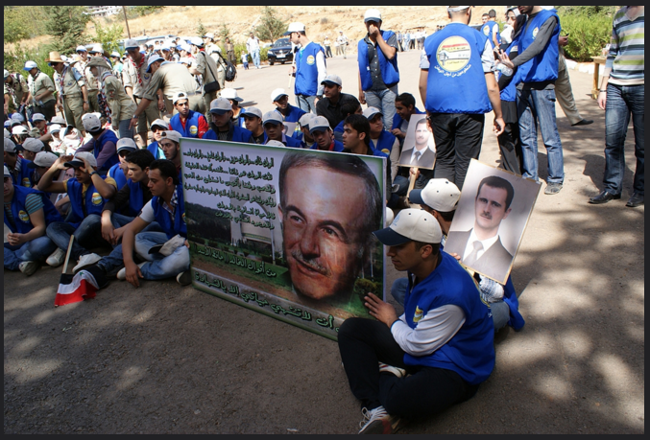

Slide 51
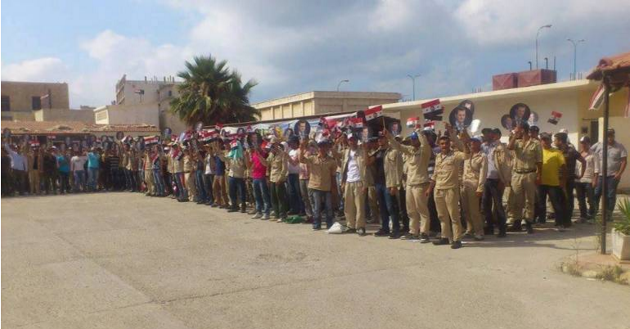

Slide 52
Syria: Education
Literacy rate of 85% (90% male, 77% female)
Two national exams: 9th and 12th grade
97% of schools are public
Language of instruction is Arabic – even in higher education
Higher education, including medical school, provided free

Slide 53
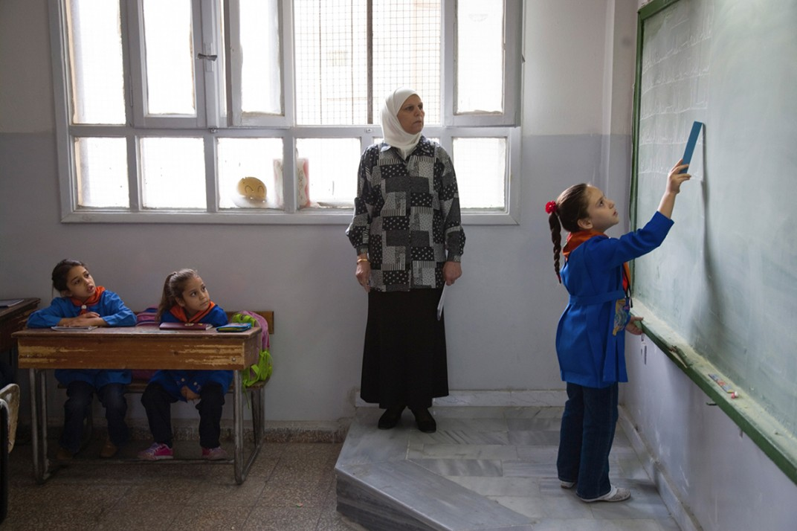

Slide 54
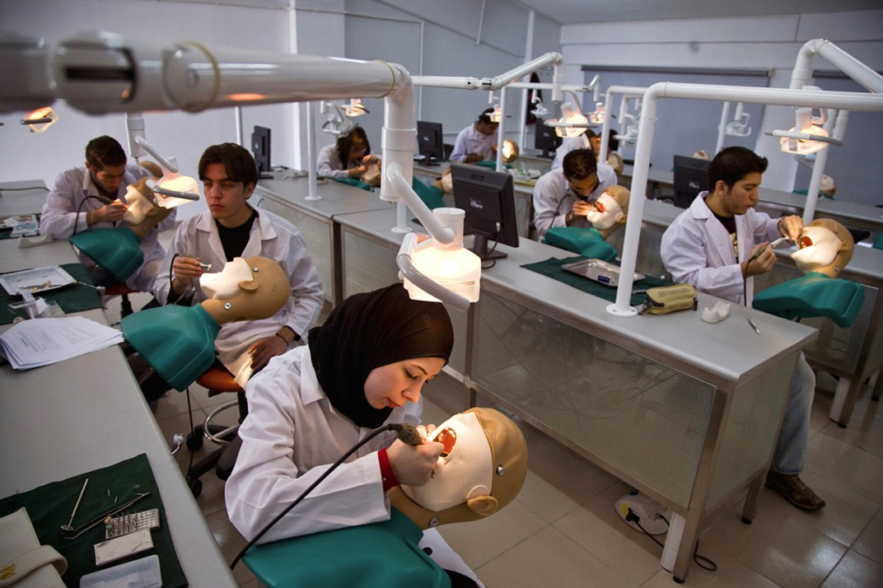

Slide 55
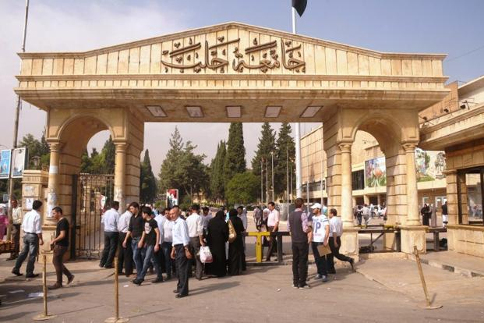

Slide 56
Syria: Society
Religion
Religion is a large part of one’s daily life – secular state
Family law is influenced by religion
Family
Families include parents, children, grandparents, aunts, uncles and cousins
Family reputation is as important as individual freedom
Notes:
Traditional vs non traditional
Religious vs non religious

Slide 58
Syria: Society
Relations
Minimal contact for opposite genders in some communities
Patriarchal society
Public affection towards members of the same gender not to be confused with sexual orientation
Socialization
More highly educated women and men socialize with individuals outside the family
Conservative women from less educated families less likely to socialize with men outside of their families

Slide 61
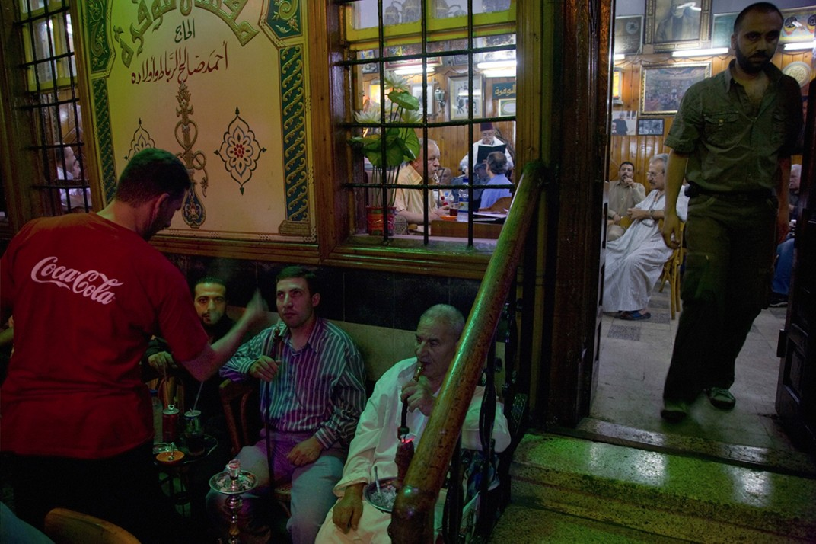

Slide 62
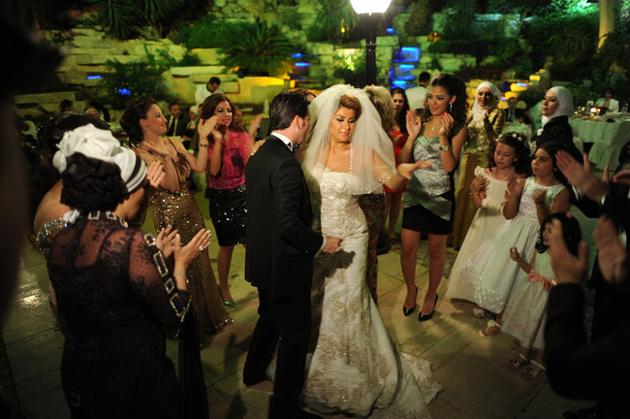

Slide 63
Syria: Parenting
Syrian parent closely
Boys often monitor the behavior of their sisters, and older girls and sometimes boys help take care of younger siblings
Discipline:
Corporal (to an extent) punishment is common in some communities
Respect of elders is continuously enforced

Slide 64
Syria: Food Etiquette
Inviting others to share one’s food is an essential courtesy
It is polite to say no the first time!
Men will always pay for a woman’s meal or tea
Men will fight over the check with the oldest or wealthiest person winning
It is considered poor manners to split the check

Slide 65
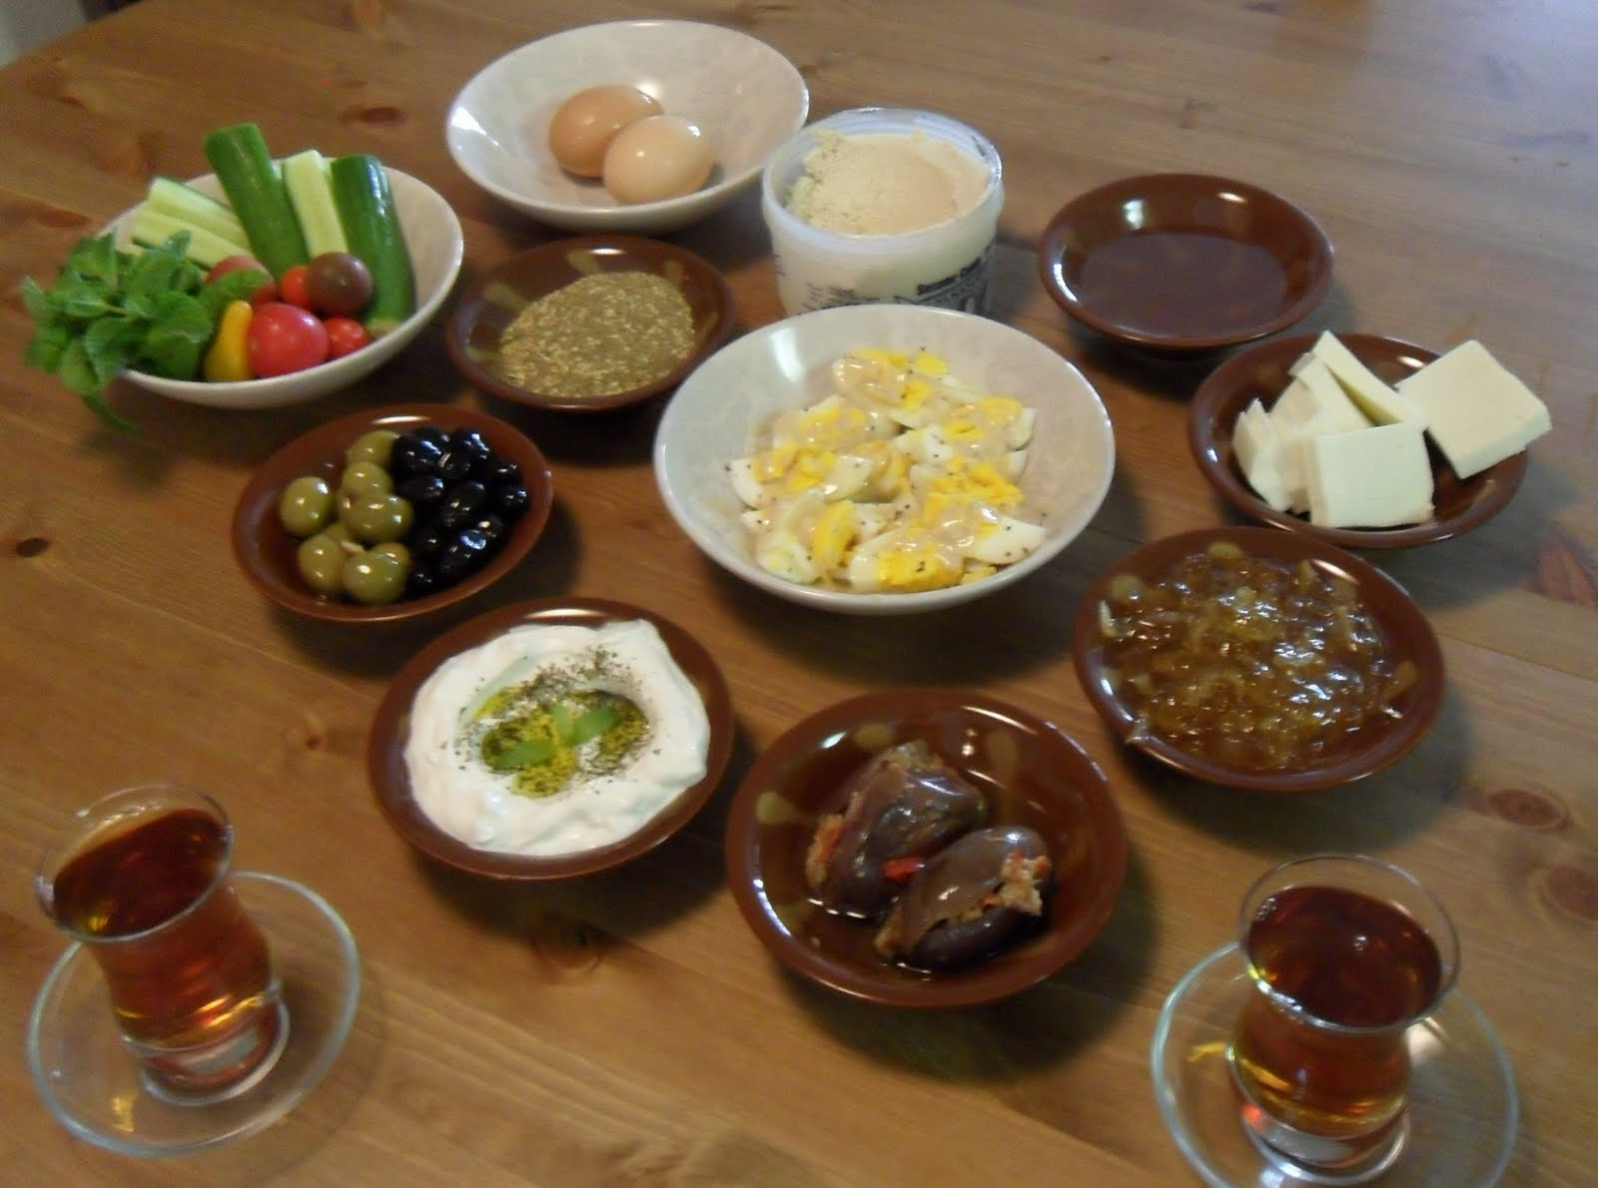

Slide 66
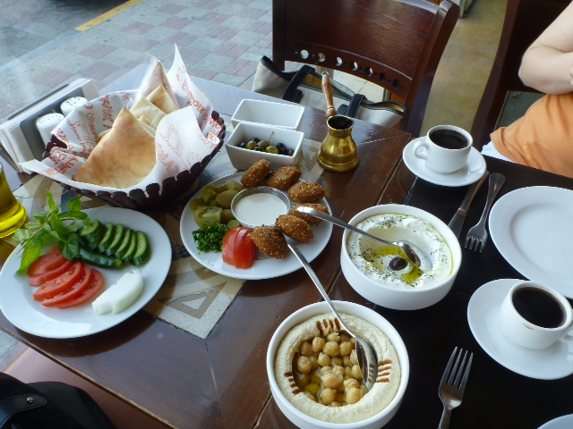

Slide 67
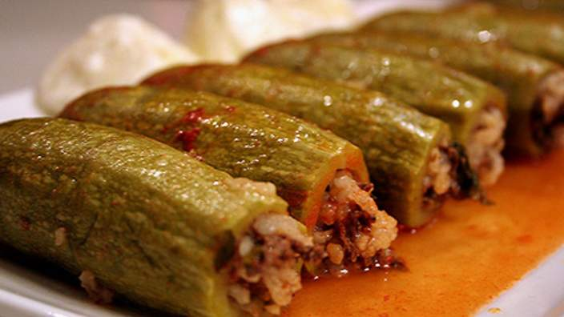

Slide 68
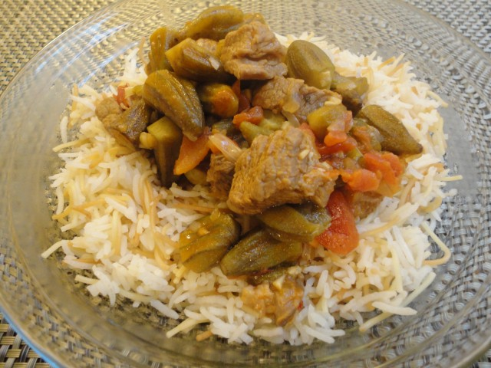

Slide 69
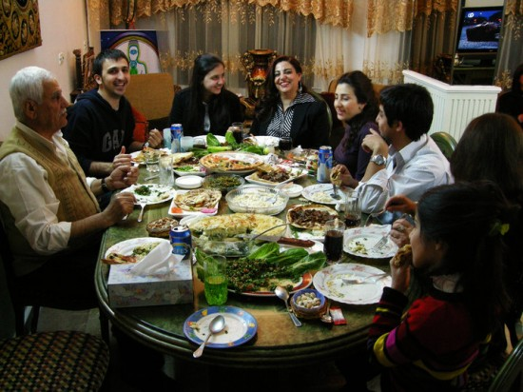

Slide 70
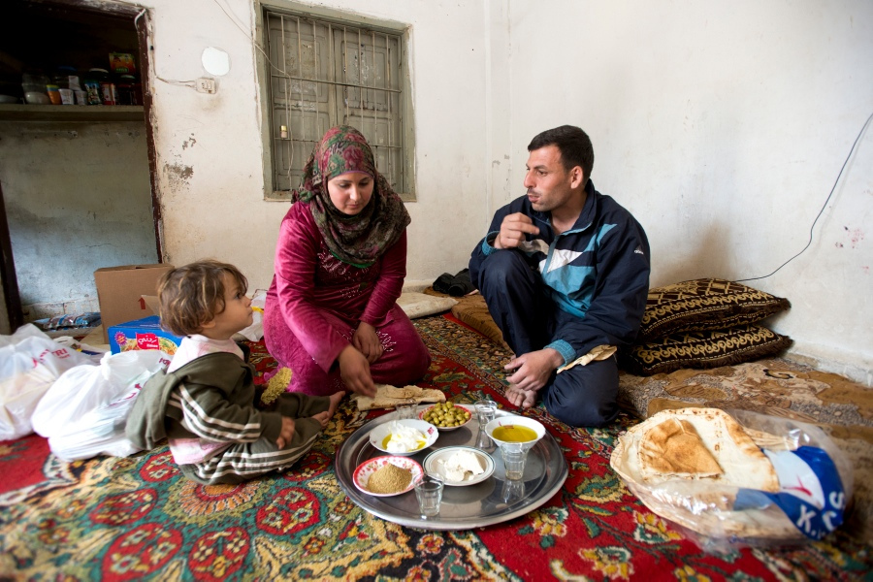

Slide 71
Syria: Health Care System and Beliefs
Syrians generally prefer to be seen by same-sex health care providers
Sexual and reproductive Health:
Syrians may be embarrassed by personal questions, particularly those having to do with sex
Sexual problems and sexually transmitted diseases are sensitive issues
Mental Health:
Many Syrians used to view mental illness as a stigma that brings shame on the family

Slide 72
Refugees in Neighboring Countries

Slide 73
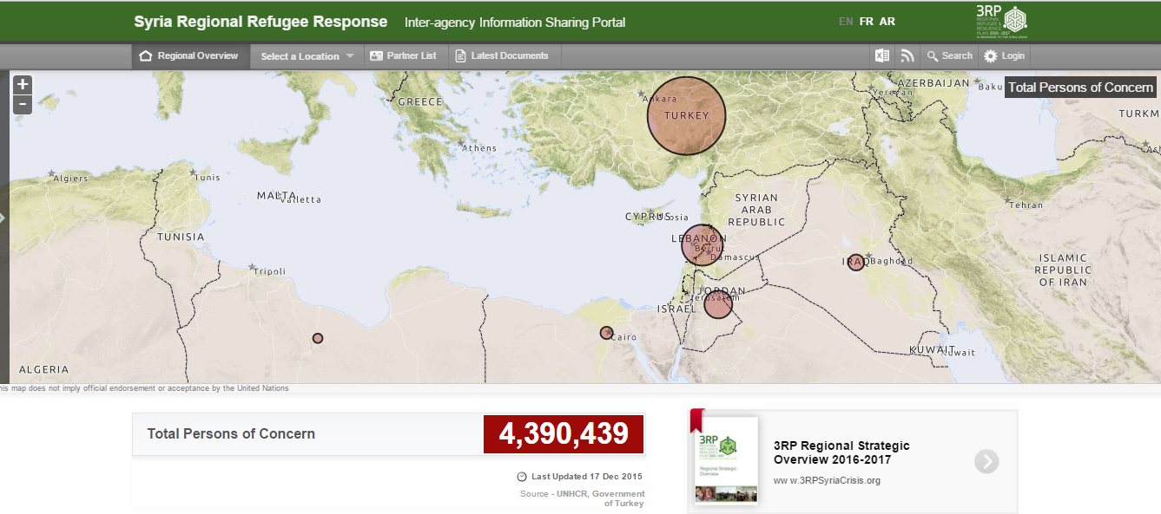
Where are the Syrians now?

Slide 74
Where are the Syrians now?
Jordan over 600,000
Turkey over 2 million
Lebanon over 1 million
Iraq over 244,000
Host communities
Camps

Slide 75
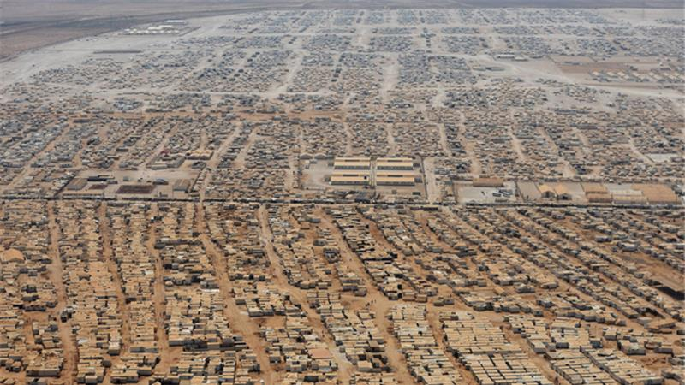

Slide 76
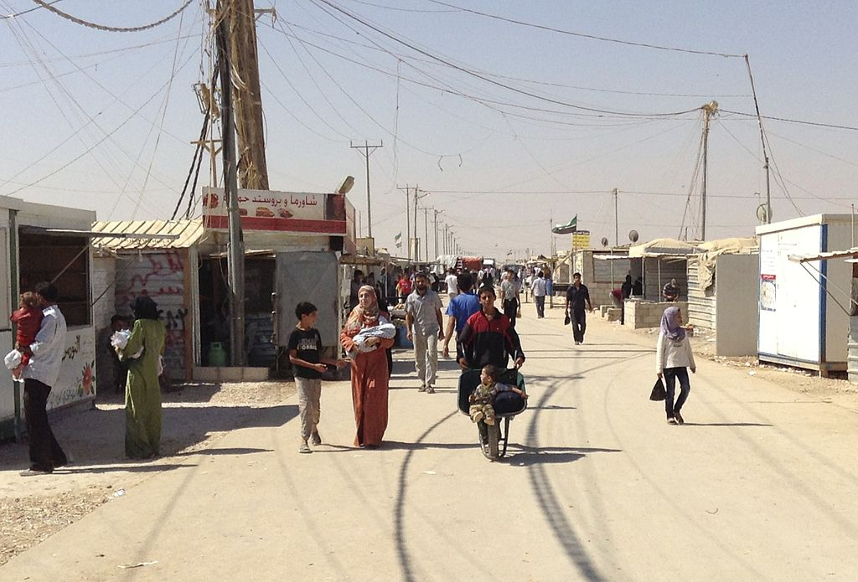

Slide 82
Refugees in neighboring countries
Informal/illegal employment, inability to generate savings, debt
Lowering wages in host communities
Increasing unemployment in host communities
Decrease in food assistance and aid due to budget cuts
World Food Programme dropped one-third of Syrian refugees from its food voucher program in Middle Eastern host countries (2015)
The maximum is now $14 per person per month for urban refugees in Lebanon and Jordan
Children forced to work, withdrawn from schools
40% of children from five conflict-scarred Middle Eastern countries, including Syria, were not in school

Slide 83
Refugees in neighboring countries
Aggression by Host Communities
Harassment by local authorities
Unbearable living conditions
“At the vaccination clinic, the women would wrap their babies in plastic bags because they don’t have the means to keep the baby dry in a tent where the water seeps from the top”

Slide 84
Refugees in neighboring countries
Psychological and emotional pressure (suicidal thoughts)
Health deterioration (disease and illness)
Domestic violence - as a result of pressures
Organized crime in camps – lawlessness
Teenage boys recruitment

Slide 86
Newcomer Syrians in Canada
Local laws regarding domestic violence and resources available
Local customs and laws regarding parenting
The police is not your enemy; the gov’t is not against you
Freedom of speech

Slide 87
Newcomer Syrians in Canada
Relations between men and women
Workplace culture differences (greetings, emails, voicemails)
Healthcare processes and referral systems
Methods of obtaining employment
Transportation systems
Education systems

Slide 88
Newcomer Syrians in Canada
Perception of time (punctuality)
Canadian politeness (please and thank you)
Status, age, and gender do not affect who is served first
Speaking in your first language
Home orientation (stove, fire alarm)
Communication style (direct vs indirect, doing vs being, oral vs literate)

Slide 89
Generalized Differences in Culture
Canada | Syria
Individualist and Independent | Collectivist and Dependent on Group
Equality: teamwork | Hierarchical: boss is authority
Task Oriented: Business 1st | Relationship Oriented: Friendship 1st
Structured Time | Flexible Time
Direct Communication Style | Diplomatic Communication Style
Written-word Culture | Spoken-word Culture
Gender Equity | Gender Division

Slide 90
Recommendations
General
Understand cultural background of family (behaviors, customs, norms)
Learn your role in family’s life
Respect confidentiality and privacy (information sharing)
Address all members of family regardless of gender, age
Explain concepts and roles, use simple language
Empower, do not create dependency

Slide 91
Recommendations
Upon Arrival
Do not hug opposite gender upon meeting
Do not show up at family’s home unannounced
Give family space the day of arrival
Do not rush non-urgent settlement- related appointments
Do not rush employment
When in doubt: JUST ASK!

Slide 92
Thank you
arabcommunitycentre.com

