Slide 1
Welcome All
☺

Slide 2
Today’s Topic
Newcomer Integration Strategies
&
How to Excel in Canadian Workforce
By: Reena Bhuchar

Slide 3
Rexdale Women’s Centre Intro :
  R.W.C is an independent, not for profit, agency that serves high-needed women and their family members residing in the GTA.
  R. W. C was established in 1978 and was incorporated in 1982.

Slide 4
Successful Newcomer Integration
Successful integration is defined as
“the ability to contribute, free of barriers, to every dimension of Canadian life – economic, social, cultural, and political.”

Slide 5
R.W.C Programs & services
We Offer Free….
Immigrant and Newcomer Settlement services
English Language Instruction
Employment and Career Support
Parenting Support
Services for Ethno-cultural seniors
Children services– program for preschoolers
Services for women who faced violence
Welcoming Community Engagement Program
Yoga and self care programs for new moms

Slide 6
MY ROLE AT REXDALE WOMEN’S CENTRE
My job title is Job developer & facilitator…
However , “I see myself as women empowerment counsellor who works closely with all newcomer women to support them in their journey for economic independence”.
Provide culturally appropriate short term supportive counseling to women when they encounter difficulties in moving ahead.

Slide 7
MY ROLE WORKING WITH NEWCOMERS WOMEN
Immigrant women, face additional barriers to finding employment and re-establishing their careers when they settle in Canada.
Offer One on One counselling services to address the barriers and challenges to find and maintain employment
Facilitate groups and educational workshops, explain the career planning process

Slide 8
How I support newcomers women to integrate to Canadian Workforce
Explaining: PROCESS OF INTEGRATION
“Integration is a two-way process, which involves commitment on the part of Immigrants and Refugees to adapt to life in Canada and on the part of Canadians to welcome and adapt to new people and cultures” –
Citizenship and Immigration Canada

Slide 9
How I support newcomer women to integrate to Canadian Workforce
Providing information about Career exploration process
Clear understanding of Canadian Work Culture
Explaining the meaning of Canadian experience
Educate and encourage for volunteer oppertunities

Slide 10
Concept of career for many newcomers
Career = Education
Career = education and experience
Career = education + experience + seniority
Concept of career and life learning
Concept of volunteer work is missing

Slide 11

Concept of career in Canada

Slide 12
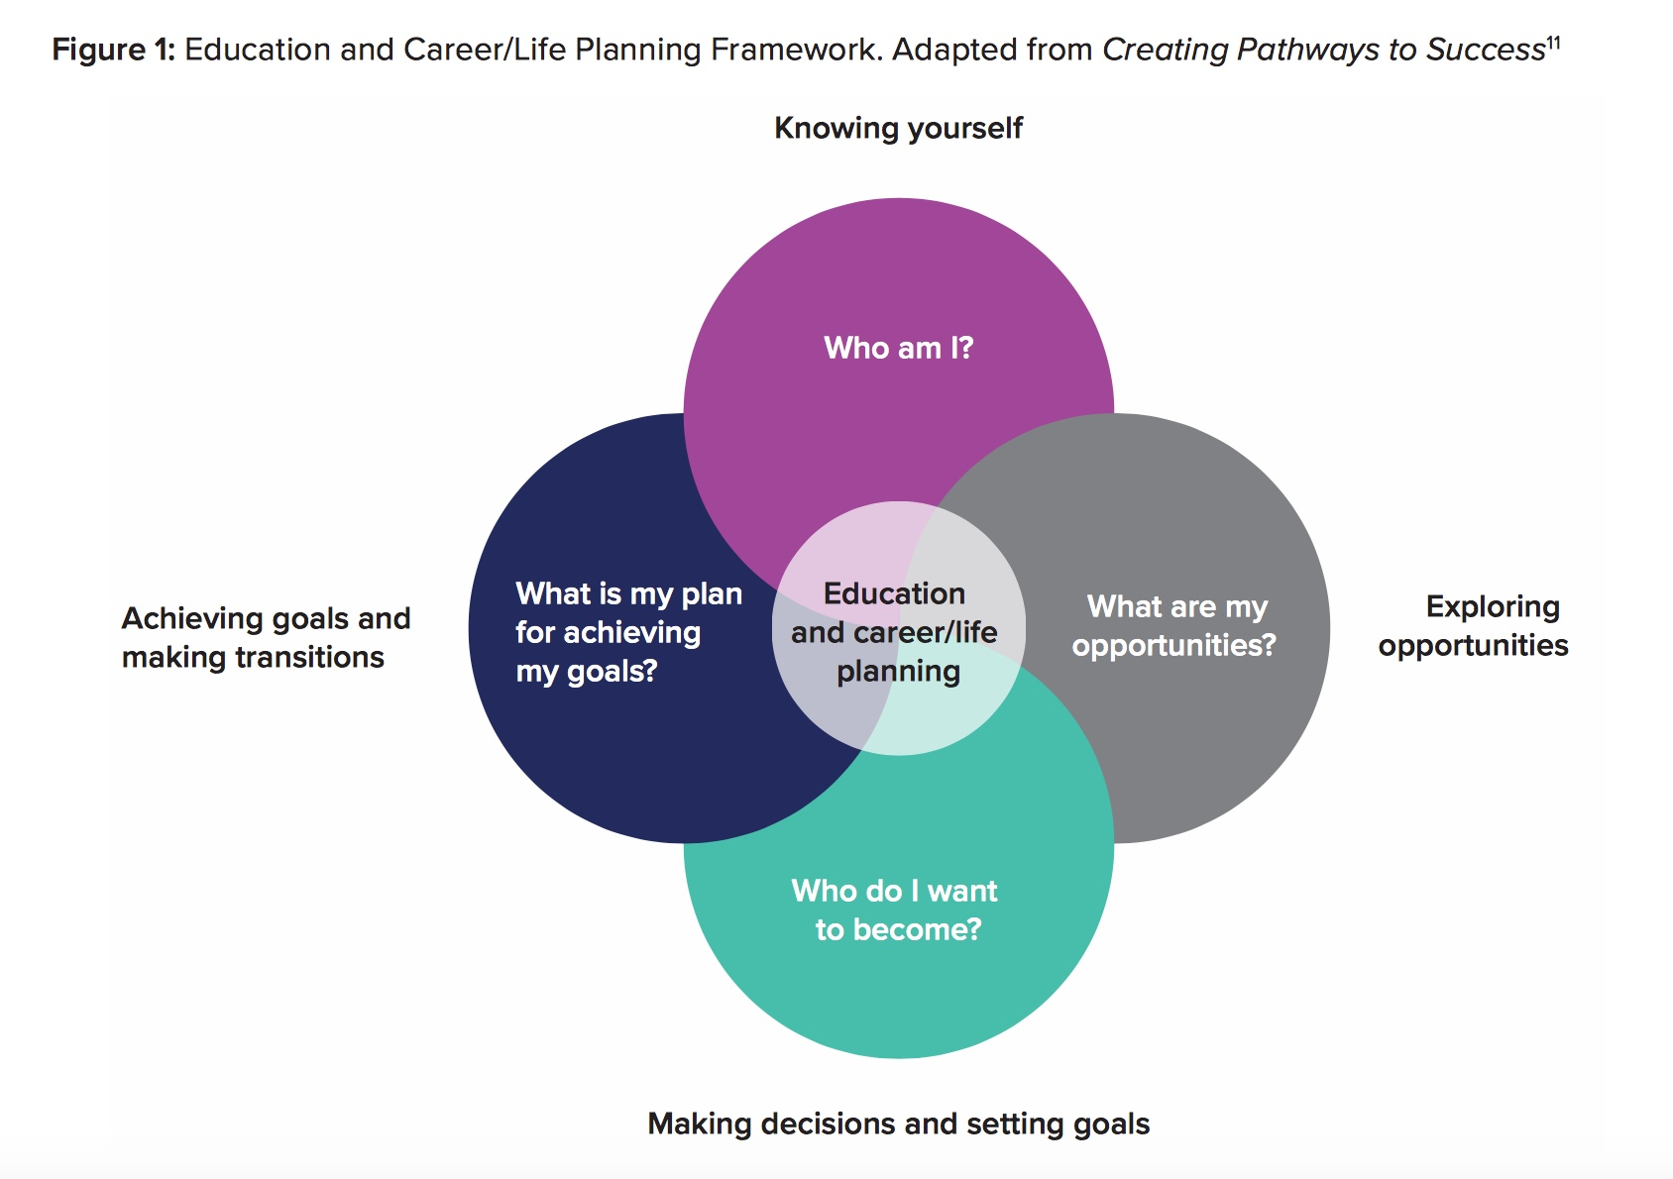
Career and life planning in Public Schools

Slide 13
Importance of Self Assessment
In my experience I have noticed newcomers comes with exceptional skills and life experiences however lack self knowledge
Through self assessment they are aware of their strengths and weaknesses
Do they really know what makes them unique
Ask them what makes them stand out

Slide 14
How authentic are you
Educate newcomers -importance of diversity and authenticity
Most employers value diversity at workplace
Recognize the important role immigrants play in building the Canadian economy Newcomers to Canada enable employers to have enough workers

Slide 15
Importance of Self Image
It is intended to support newcomers capacity for self-discovery and to build their self-knowledge
develop this self-awareness
level of self-knowledge determine your competitiveness in the job market and the degree of career success and meaningfulness one has.
become more self-aware in order to find fulfilment in their careers

Slide 16
What is Canadian Experience
There is no such thing as Canadian Experience :
Canadian Experience = Relevant Experience
Canadian Experience = Paid or unpaid work experience
Canadian Experience = Soft Skills
Teamwork
Communication
Flexibility
Patience
Time management
Motivation
Problem Solving
Active Listening
Positive Attitude

Slide 17
What are essential skills?
Essential skills are the skills that people need for work, learning and life. This profile contains a list of example tasks that illustrate how each of the 9 essential skills is generally performed by most workers in this occupation. The levels of complexity estimated for each task are ranked between 1 (basic) and 5 (advanced).

Slide 18
Example of soft skills needed in a job
Hairstylists and Barbers(6341)
This profile has been developed by Skills Competence's Canada.
Hairstylists and barbers cut and style hair and perform related services. They are employed in hairstyling or hairdressing salons, barbershops, vocational schools, healthcare establishments and theatre, film and television establishments.
Reading Help - Reading Document use Help - Document use Writing Help - Writing Numeracy Help - Numeracy Oral communication Help - Oral communication Thinking Help - Thinking Digital technology Help - Digital technology Additional information Help - Additional information
[Source:Literacy and Essential Skills - ESDC]

Slide 19
Examples of hard skills include:
Proficiency in a foreign language
A degree, diploma or certificate
Typing speed
Machine operation
Computer programming
Knowledge of specific tourist attractions

Slide 20
Examples of soft skills include:
Teamwork
Communication
Flexibility
Patience
Time management
Motivation
Problem Solving
Active Listening
Positive Attitude

Slide 21
TECHNICAL/PRACTICAL SKILLS
Administrative Skills
Writing Skills
Foreign Language
Computer Skills
Art & Design
Telephone Skills
Using My Hands
People/Customer Skills

Slide 22
What Employers Want ?
Employers want to hire people who have more Employability Skills
Employability skills are the knowledge, attributes and experiences that you obtain to help you prepare for your career. These qualities enable you to adapt and manage the constantly changing work environment

Slide 23
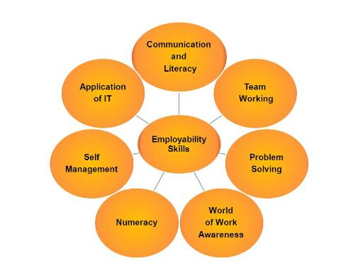

Slide 24
Share Customer Service Example
Share recent pizza hut order experience
Lack of listening and customer service skills
Lack of patience and ability to receive constrictive feedback
Lack of professionalism – without putting customer on hold speaking in own language
Keeping on hold for 35 minutes and changing CS reps
According to recent survey employers are suffering as employee’s don’t have people skills

Slide 25
What are people skills ?
People skills are defined as the ability to listen, to communicate and to relate to others on a personal or professional level.
Good people skills also extend to include problem-solving abilities, empathy for others and a willingness to work together toward the common good.
Ability to Work Under Pressure

Slide 26
People skills (aka) Interpersonal Skills
Decision Making
Time Management
Self-motivation
Conflict Resolution
Leadership
Adaptability
Active listening skills
Flexibility
Good judgment

Slide 27
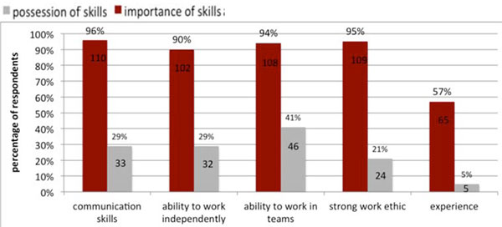
What Employers Want ?

Slide 28
Example of gov job requirement
ALL STREAMS
Judgement/Analytical Thinking
Focus on Quality and Details
Adaptability and Flexibility
Values and Ethics
Effective Interactive Communication
Adaptability and flexibility
Time manegment

Slide 29
3 Top industries with employment growth by 2026
Health care is projected to become the largest employer with 2.2 million workers by 2026, surpassing retail trade by 83,000 workers. Construction is expected to remain in third position with 1.5 million workers. With a total of 5.9 million workers by the end of the projection period, those three industries are expected to account for 30% of overall employment

Slide 30
Employment: Manufacturing sector
1. Fabricated Metal Products and Machinery
2. Food and Beverage Products
3. Motor Vehicles, Trailers and Parts
4. Plastics and Rubber Products
5. Aerospace, Rail, Ship and Other Transp. Equip.
6. Primary Metals and Mineral Products
7. Miscellaneous Manufacturing
8. Chemical Products
9. Wood Products
10. Textiles, Clothing, Leather and Furniture
11.Printing and Related Activities -0.9%
12.Computer, Electronic and Electrical Products -1.2%
13. Paper Manufacturing -1.4%

Slide 31
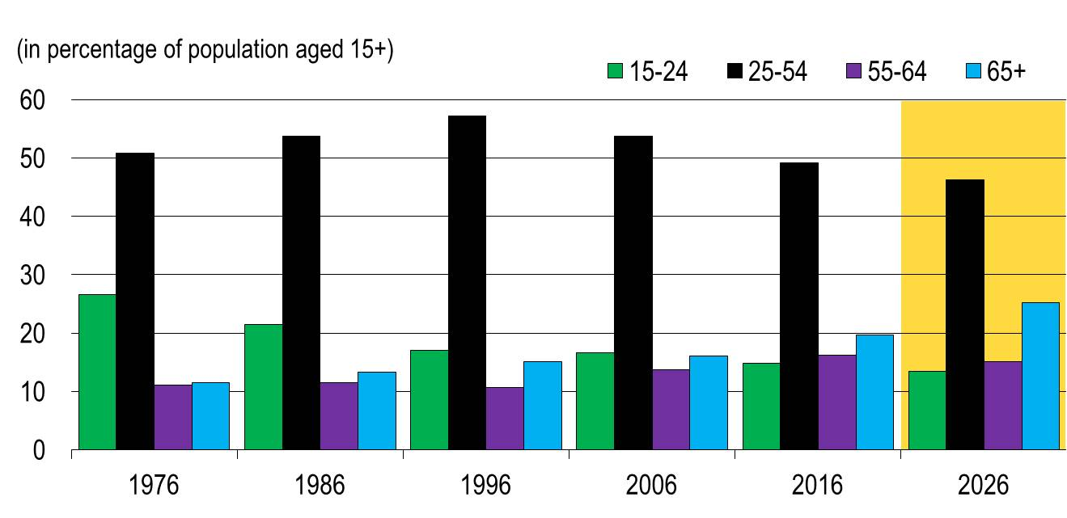
Population entering workforce by 2026

Slide 32
How to excel in Canadian workforce
By educating newcomers about Canadian workplace values
  environment is more open and gives you opportunities to show your overall personality, take initiatives, show cultural respect, importance of team work,
  Freedom to voice your opinion and express yourself and your feelings ( which helps creative people to generate new ideas and provide new opportunities

Slide 33
How to excel in Canadian workforce
By offering newcomers informative workshops
People succeed by:
Building Confidence
Showcasing leadership qualities
Asking questions
Engaging and networking with others
Personnel Branding
Explore volunteer opportunities
Knowing who you are is very crucial ☺

Slide 34

Employment Success for Newcomer Women

Slide 35

Climb the Ladder of Life
Recognise, Develop and Sell Your Employability Skills

Slide 36

Rexdale Women’s Centre
Thank you ☺
Reena Bhuchar

